Slide 1


MCP Server: The Phone Catalog for AI Agents
SOFIA
Dennes Torres
04|10|25

Slide 2








OUR SPONSORS
‘’A Huge Thank You’’ to Our Sponsors Before we dive into the session, we want to take a moment to express our heartfelt gratitude to the incredible sponsors who made Data Saturdays Sofia 2025 possible
www.datasaturday.eu/DataSaturdaySofia

Slide 3







Dennes Torres Data Platform MVP (Alumni)
Dtower Software
https://dtowersoftware.com
Trainer
MCT, Azure Solutions Architect, Azure Data Engineer and Azure DevOps Engineer
Malta Data Platform UG Leader
Malta
MMDPUG
https://www.facebook.com/MMDPUG
http://dennestorres.com
Dennes.Torres
@Dennes
https://br.linkedin.com/in/dennestorres
dennes@bufaloinfo.com.br
http://youtube.com/c/dennestorres

Slide 4
Agenda
The problem its made for
How MCP Server works
How to test MCP Servers
Foundry Deployment for MCP Servers
How to connect Foundry to an MCP Server
How to create an MCP Server
www.datasaturday.eu/DataSaturdaySofia

Slide 5

The Problem MCP’s are Made for
https://datasaturday.eu/DataSaturdaySofia

Slide 6
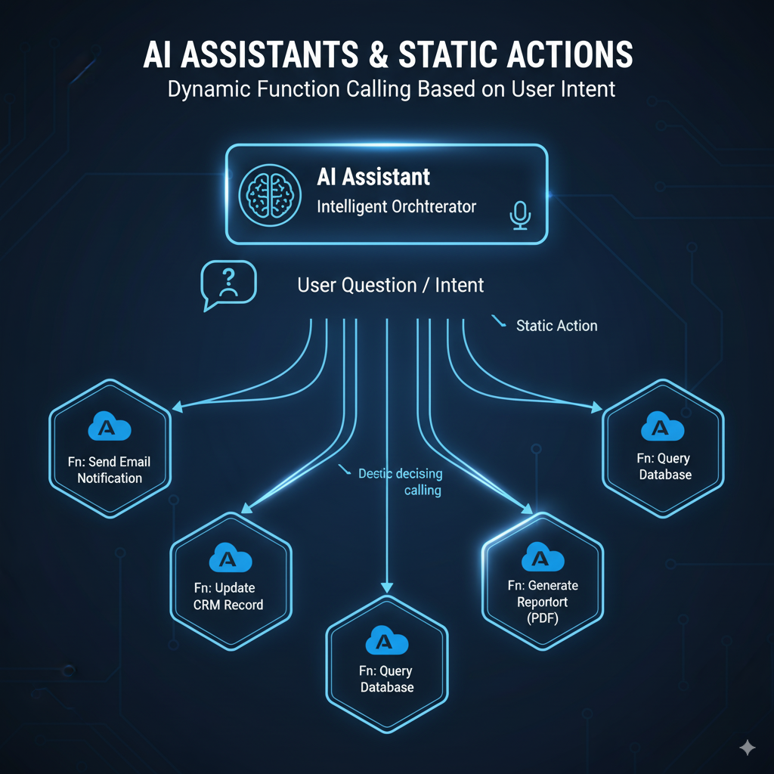
We want to link Agents with Actions
www.datasaturday.eu/DataSaturdaySofia

Slide 7
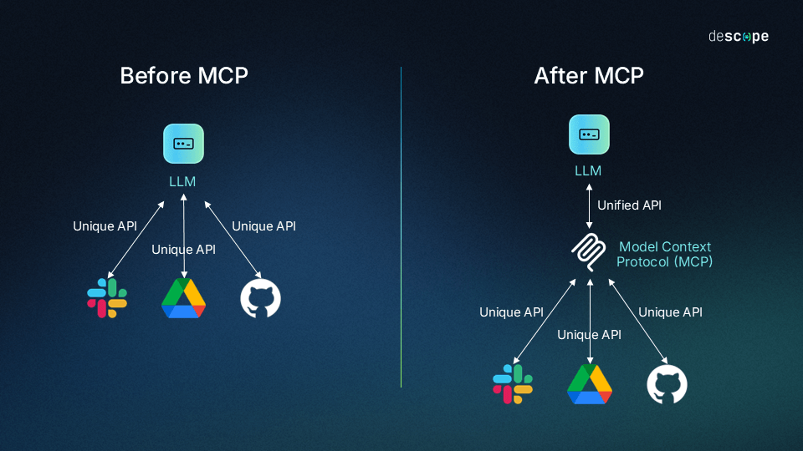
Multiple Communication Protocols are the challenge
www.datasaturday.eu/DataSaturdaySofia

Slide 8
Every tool decided to create their own MCP to be available for AI Agent
MSLearn MCP
Azure MCP
Power BI Desktop MCP
Influencer Marketing
Email Marketing Campaign
Azure Foundry MCP
Fabric MCP
www.datasaturday.eu/DataSaturdaySofia

Slide 9
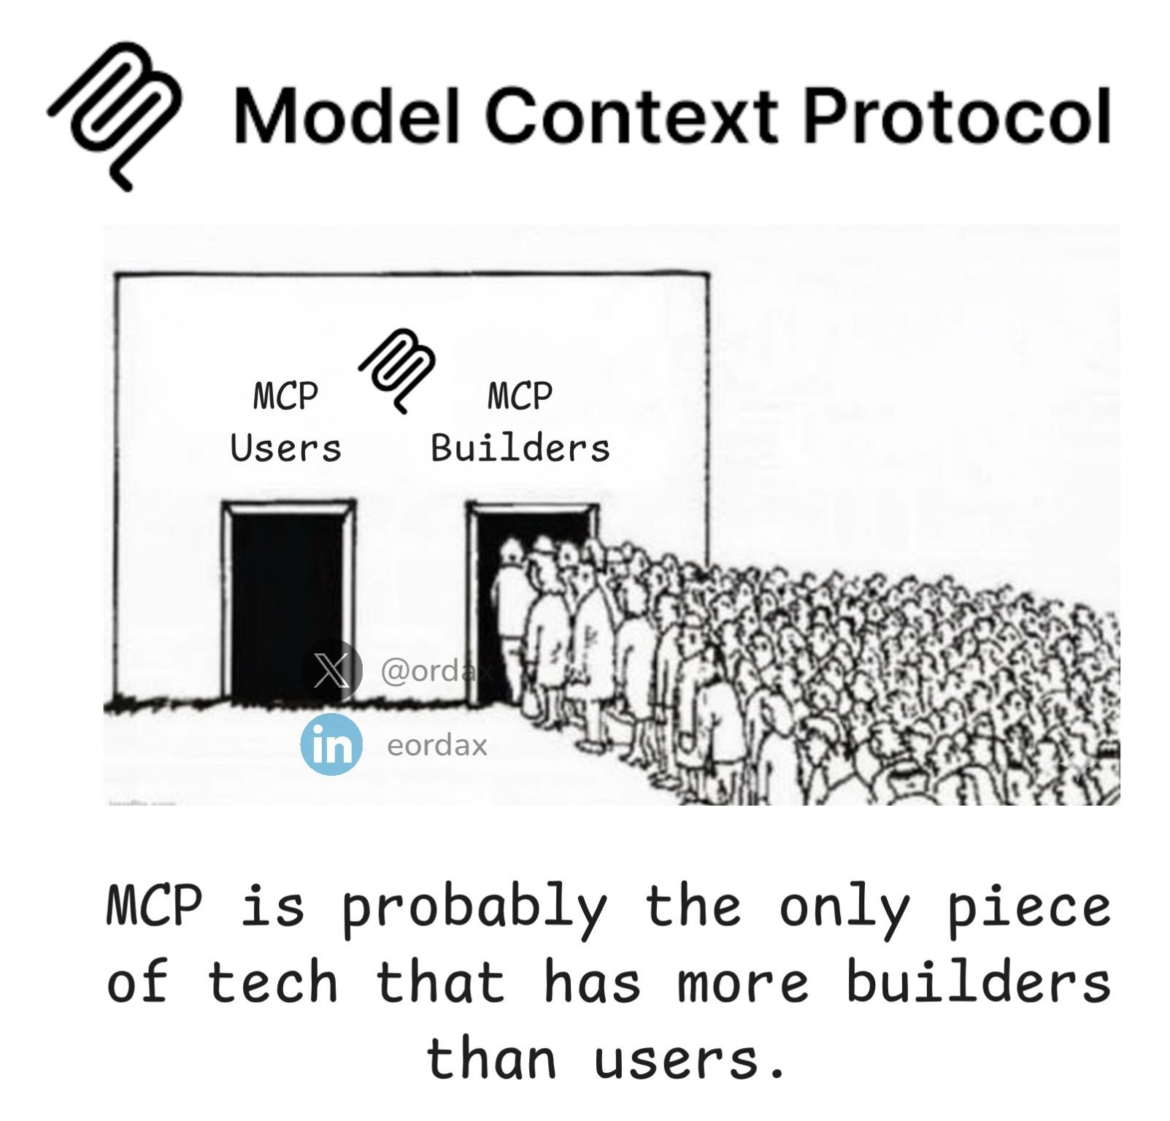
Social Media Advertising
Influencer Marketing
Email Marketing Campaign
www.datasaturday.eu/DataSaturdaySofia

Slide 10
How MCP Server Work
https://datasaturday.eu/DataSaturdaySofia

Slide 11
How MCP Servers work
MCP Server have tools
Each tool is a single API call
MCP Server list the tools
MCP Server is a proxy to call the tools
Each Server focus on one purpose
Social Media Advertising
Email Marketing Campaign
www.datasaturday.eu/DataSaturdaySofia

Slide 12
SSE
Single Stateless Calls
GET Calls
Azure Functions are an example
Streamable HTTP
Continuous statefull call
POST call
Example: MSLearn
Azure Functions make it partially (POST)
STDIO
In-Process call
Testing or special scenarios
MCP Connection Protocol
Social Media Advertising
Influencer Marketing
Email Marketing Campaign
www.datasaturday.eu/DataSaturdaySofia

Slide 13
How to Create an MCP Server
https://datasaturday.eu/DataSaturdaySofia

Slide 14
Frameworks for MCP Servers
C# MCP SDK
Core SDK to build MCP Servers
Support all MCP connection protocols
Demo using Console App
Azure Function MCP Extension
Based on the core MCP SDK
Only SSE connection protocol
Uses Azure Function Bindings and Triggers
Social Media Advertising
Influencer Marketing
Email Marketing Campaign
www.datasaturday.eu/DataSaturdaySofia

Slide 15
Developing the Azure Function
Install the Nuget Package
Social Media Advertising
Influencer Marketing
www.datasaturday.eu/DataSaturdaySofia

Slide 16
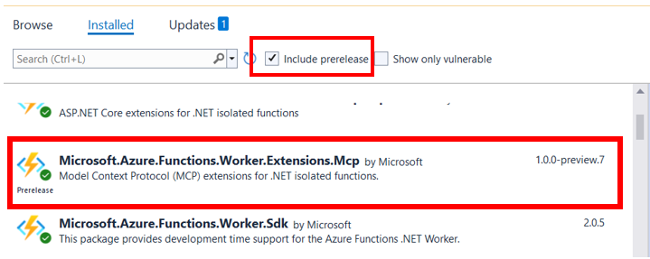
Nuget Package
Social Media Advertising
Influencer Marketing
Email Marketing Campaign
www.datasaturday.eu/DataSaturdaySofia

Slide 17
Developing the Azure Function
Use McpToolTrigger on the function method
Each parameter is a property and needs to use McpToolProperty
Install the Nuget Package
Social Media Advertising
Influencer Marketing
www.datasaturday.eu/DataSaturdaySofia

Slide 18
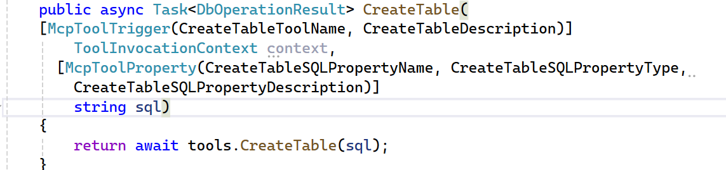
Azure Function Trigger and Binding
Social Media Advertising
Influencer Marketing
Email Marketing Campaign
www.datasaturday.eu/DataSaturdaySofia

Slide 19
Developing the Azure Function
Use McpToolTrigger on the function method
Each parameter is a property and needs to use McpToolProperty
Register each method in the startup
Each parameter is also registered at startup
Install the Nuget Package
Social Media Advertising
Influencer Marketing
www.datasaturday.eu/DataSaturdaySofia

Slide 20
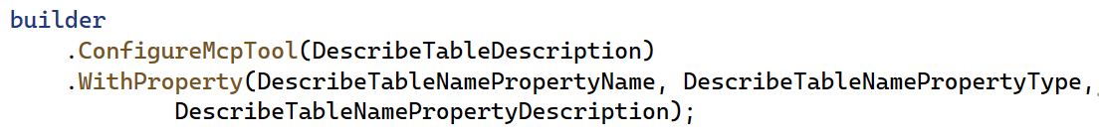
Data Saturdays Sofia
Social Media Advertising
Influencer Marketing
Email Marketing Campaign
www.datasaturday.eu/DataSaturdaySofia

Slide 21
MCP Parameter Type Support
String
Integer
Float
Boolean
enum (as string with an "enum" list)
object (with "properties" mapping to the above types)
array (of the above types)
Social Media Advertising
Influencer Marketing
Email Marketing Campaign
www.datasaturday.eu/DataSaturdaySofia

Slide 22
Azure Function MCP Security
Default implementation uses a fixed key
The key is required – no option to disable it
The key is located as a custom implementation in API Keys
A header is used to pass the key: x-functions-key
It can also be passed on the query string: ?code=
Social Media Advertising
Influencer Marketing
Email Marketing Campaign
www.datasaturday.eu/DataSaturdaySofia

Slide 23
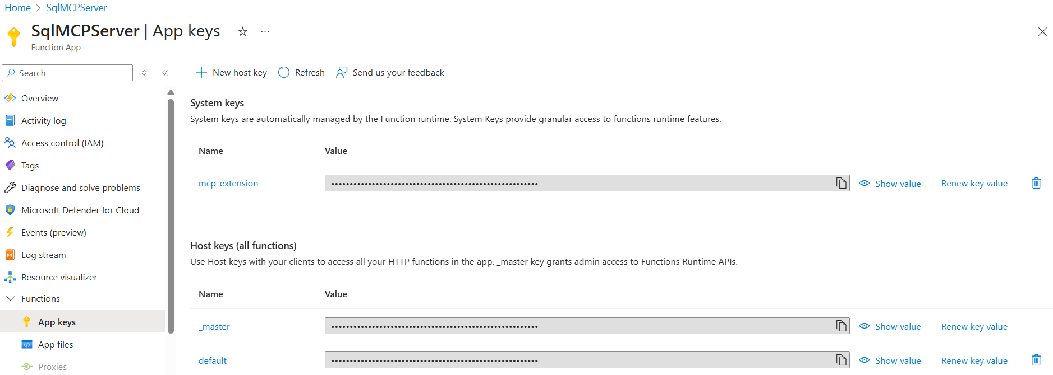
MCP Server Access Key
www.datasaturday.eu/DataSaturdaySofia

Slide 24
Acess Key and Endpoints
SSE Endpoint: https://<function>/runtime/webhooks/mcp/sse Streamable Endpoint https://<function>//runtime/webhooks/mcp
Query String: ?Code=<Access Key>
Header: x-functions-key
Influencer Marketing
Email Marketing Campaign
www.datasaturday.eu/DataSaturdaySofia

Slide 25
Demo
Building a MCP Server
www.datasaturday.eu/DataSaturdaySofia

Slide 26
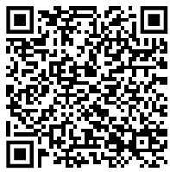
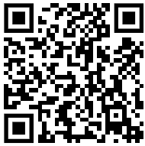
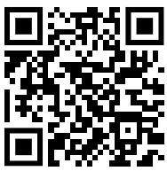
References
MCP Bindings Documentations
MCP Bindings Repository
C# MCP SDK
Social Media Advertising
Influencer Marketing
Email Marketing Campaign
www.datasaturday.eu/DataSaturdaySofia

Slide 27
How to Test an MCP Server
https://datasaturday.eu/DataSaturdaySofia

Slide 28
MCP Server Testing Tools
MCP Inspector
Source Code on Github
Installed as Container Instance
List the MCP tools
Execute MCP tools
Apify
Builds a test Agent
Connects the Agent to the MCP
Social Media Advertising
Influencer Marketing
Email Marketing Campaign
www.datasaturday.eu/DataSaturdaySofia

Slide 29
Demo
Testing MCP Servers
www.datasaturday.eu/DataSaturdaySofia

Slide 30
Installing MPC Inspector
az container create \
--resource-group rg-entmcpinspector \
--name entmcpinspector \
--image ghcr.io/modelcontextprotocol/inspector:latest \
--ports 6274 6277 \
--os-type Linux \
--environment-variables \
HOST=0.0.0.0 \
SERVER_PORT=6277 \
CLIENT_PORT=6274 \
MCP_PROXY_AUTH_TOKEN=<<password>> \
MCP_AUTO_OPEN_ENABLED=false \
ALLOWED_ORIGINS=http://entmcpinspector.uksouth.azurecontainer.io:6274,http://entmcpinspector.uksouth.azurecontainer.io:6277 \
--restart-policy Always \
--dns-name-label entmcpinspector \
--location uksouth \
--cpu 1 \
--memory 2
www.datasaturday.eu/DataSaturdaySofia

Slide 31
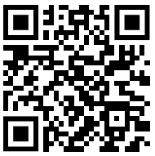
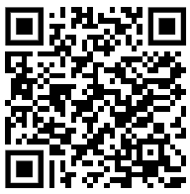
References
MCP Inspector Repository
How to Install and Use them
Apify MCP Test
Social Media Advertising
Influencer Marketing
Coming Soon
Email Marketing Campaign
www.datasaturday.eu/DataSaturdaySofia

Slide 32
Copilot Studio Architecture for Agents and MCPS
https://datasaturday.eu/DataSaturdaySofia

Slide 33
Copilot and MCPs
We create agents
We create a connector to an MCP
We create a connection to the MCP (carries the authentication)
The connector is inserted in the agent
Connector and Connection are best administered in Power Apps
Social Media Advertising
Influencer Marketing
Email Marketing Campaign
www.datasaturday.eu/DataSaturdaySofia

Slide 34
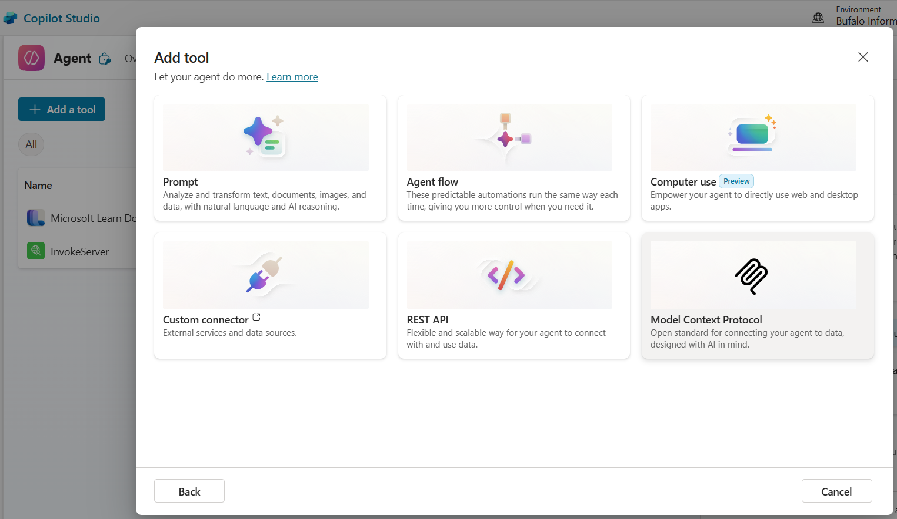
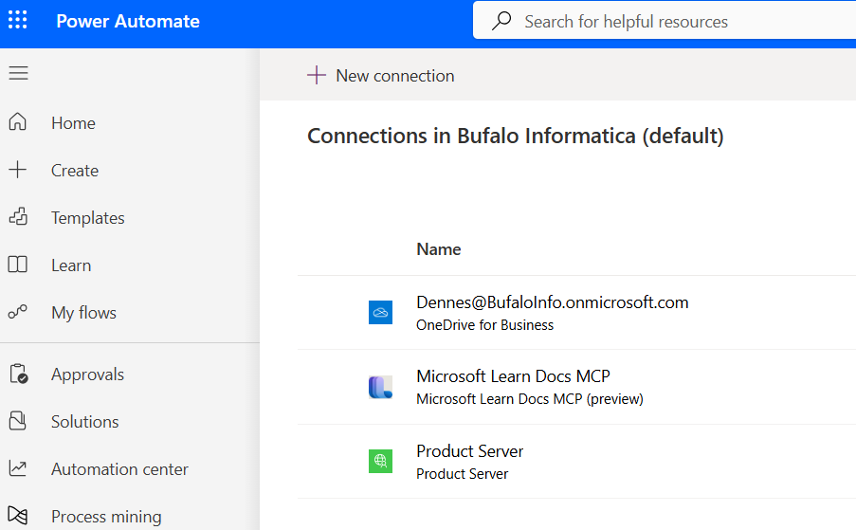
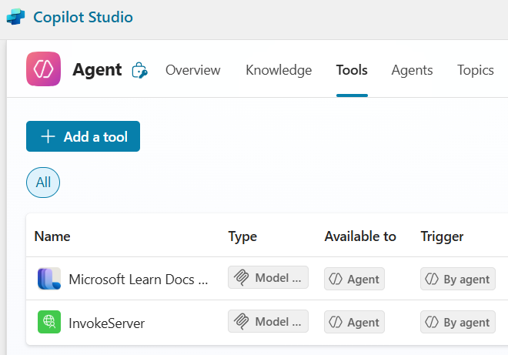
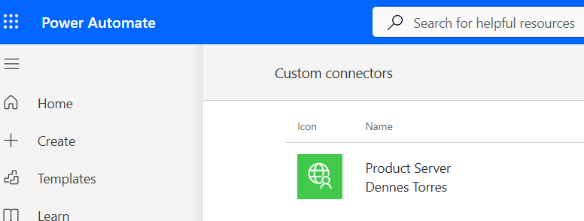
Copilot and MCP’s
Social Media Advertising
Influencer Marketing
Email Marketing Campaign
www.datasaturday.eu/DataSaturdaySofia

Slide 35
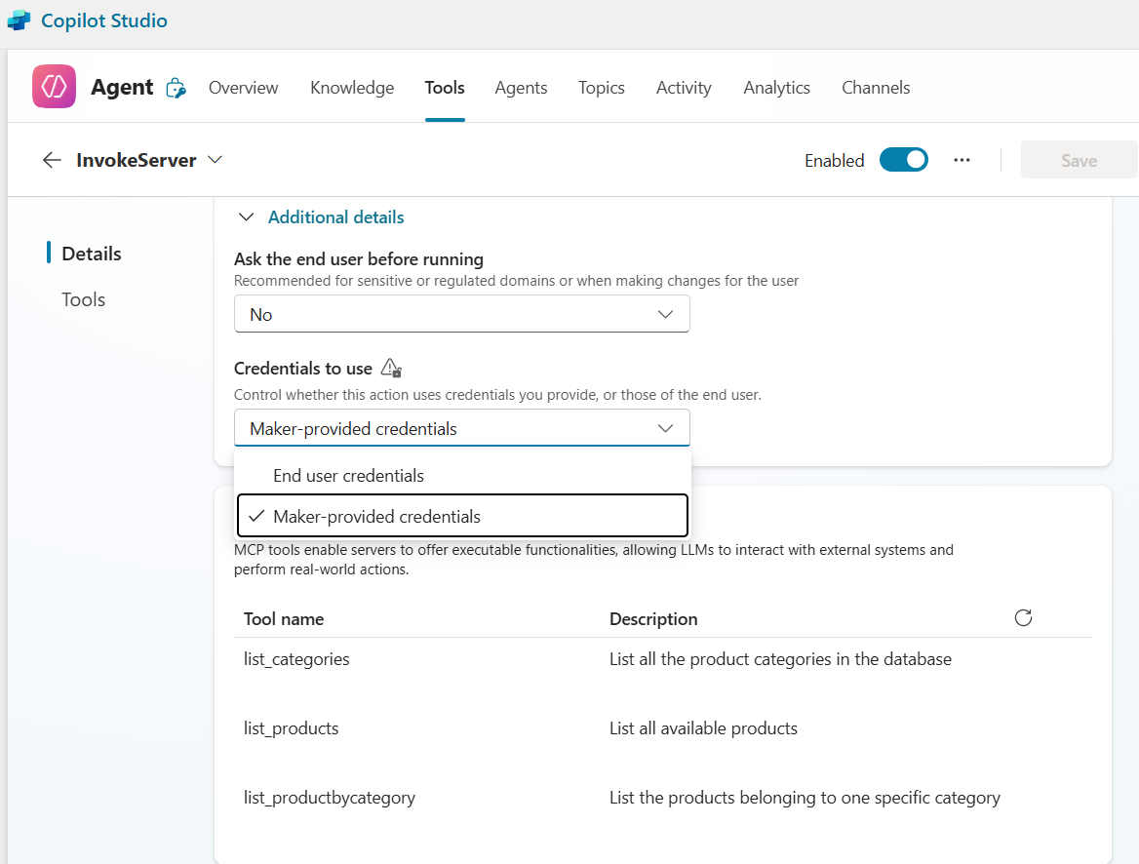
Security and Tools
Social Media Advertising
Influencer Marketing
Email Marketing Campaign
www.datasaturday.eu/DataSaturdaySofia

Slide 36
Demo
Testing MCPs in Copilot Studio
www.datasaturday.eu/DataSaturdaySofia

Slide 37

Have a question?
https://datasaturday.eu/DataSaturdaySofia

Slide 38
Dennes Torres Data Platform MVP (Alumni)
Dtower Software
https://dtowersoftware.com
Trainer
MCT, Azure Solutions Architect, Azure Data Engineer and Azure DevOps Engineer
Malta Data Platform UG Leader
Malta
MMDPUG
https://www.facebook.com/MMDPUG
http://dennestorres.com
Dennes.Torres
@Dennes
https://br.linkedin.com/in/dennestorres
dennes@bufaloinfo.com.br
http://youtube.com/c/dennestorres

Slide 39
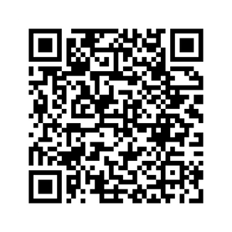
Thank you
Follow next event

